Slide 1


Maths
Number and Place Value
Year One
Maths | Year 1 | Number and Place Value | Identify and Represent Numbers 0-50 | Lesson 2 of 3: Sports Day

Slide 3
Aim
I can recognise and show numbers up to 50 using pictures.
Success Criteria
I can recognise written numbers up to 50.
I can recognise numbers up to 50 shown as pictures.
I can show numbers up to 50 using pictures.

Slide 4


Work Out
Can you work out which number this is?
How do you know?
22
Can you count up from this number?
Can you count back from this number?

Slide 5
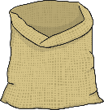
Work Out
Can you work out which number this is?
How do you know?
25
Can you count up from this number?
Can you count back from this number?

Slide 6
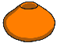
Work Out
Can you work out which number this is?
How do you know?
36
Can you count up from this number?
Can you count back from this number?

Slide 7
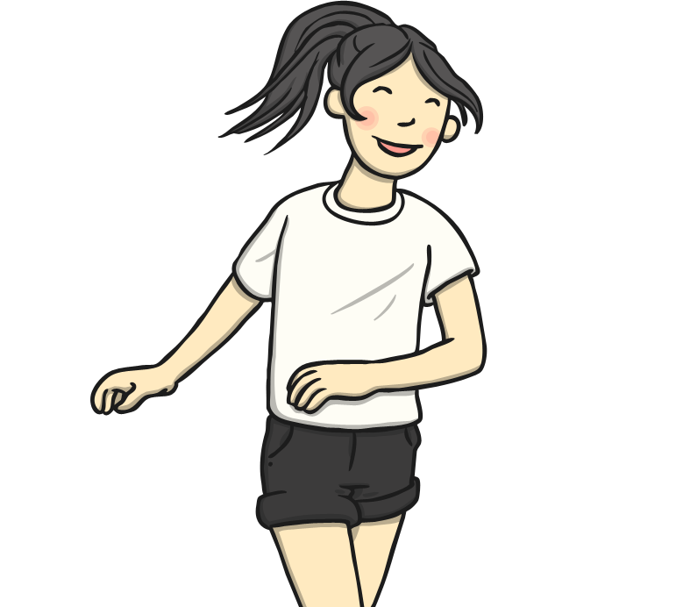
Work Out
14
?
Can you say this number?
How many tens are in this number?
How many ones are in this number?
?
?
Can you count up from this number?
Can you count back from this number?

Slide 8

Work Out
How many stickers have the Red Team won?
How many tens are in this number?
How many ones are in this number?
?
Sports Day Scoreboard
Team
Stickers Won
Red Team
47
?
?
Can you count up from this number?
Can you count back from this number?

Slide 9

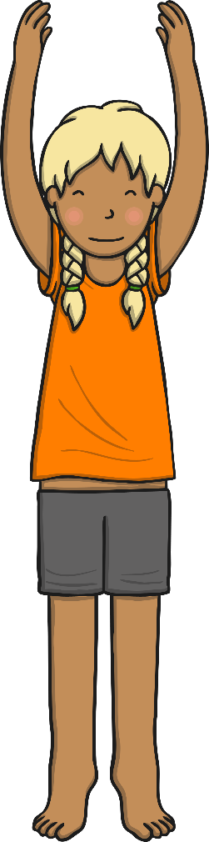
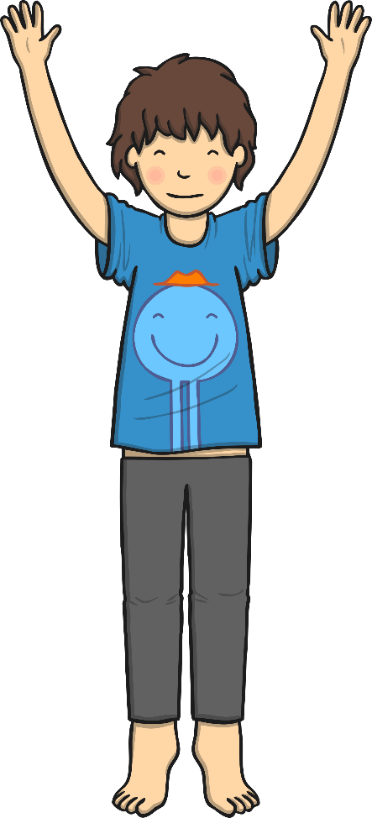

Warm-Up
Let’s get our brains warmed up!
What number is this? Whisper it to your partner.
1
It represents 1. There is 1 cube.

Slide 10

Warm-Up
Let’s get our brains warmed up!
What number is this? Whisper it to your partner.
10
9
8
7
6
5
4
3
2
1
It represents 10. There are 10 cubes in the tower.

Slide 11

Warm-Up
Let’s get our brains warmed up!
What number is this? Whisper it to your partner.
16
15
14
13
12
11
10
It represents 16.
There is a tower of ten and six more cubes.
There are 16 cubes altogether.

Slide 12

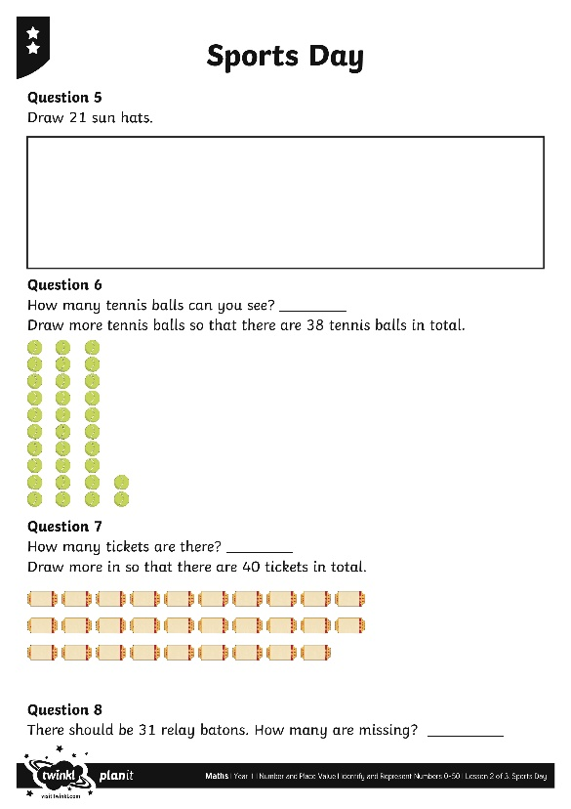
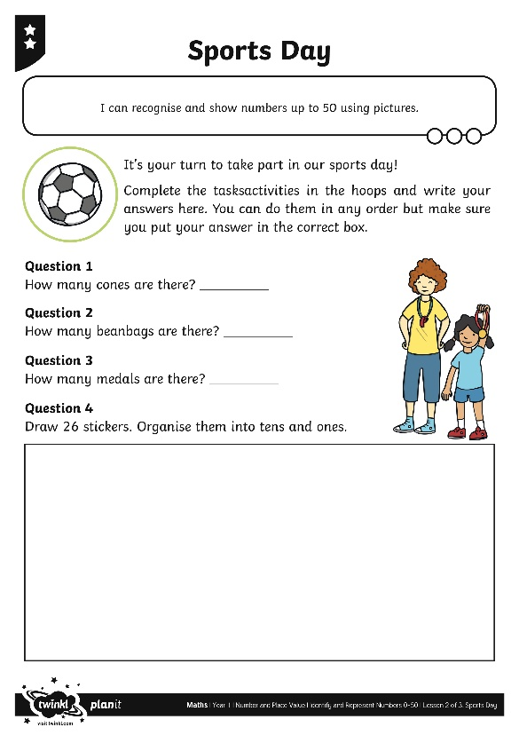
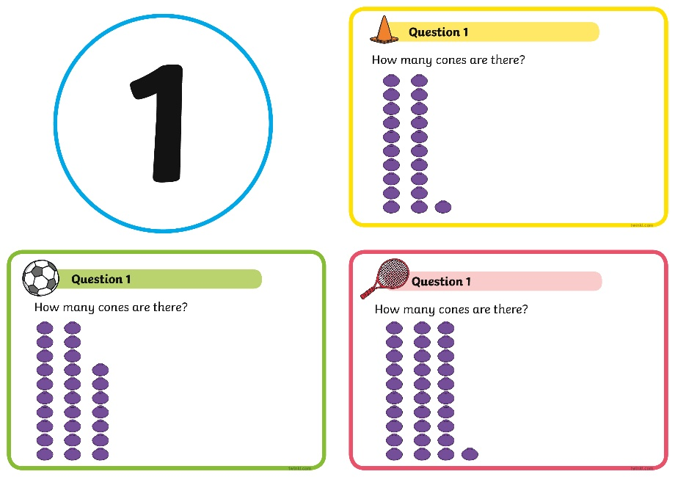
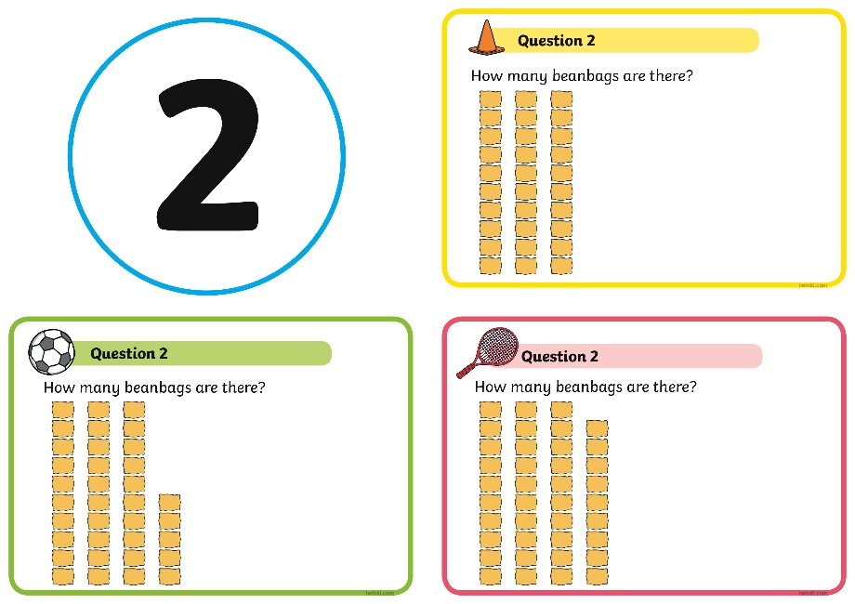
Sports Day
Find the Sports Day Cards around the room. Each card has a number on it but you can do them in any order. You will be told to look for: the cone, the football or the racket. Complete the tasks next to that symbol and write your answers in the correct box on your Sports Day Activity Sheets.

Slide 13
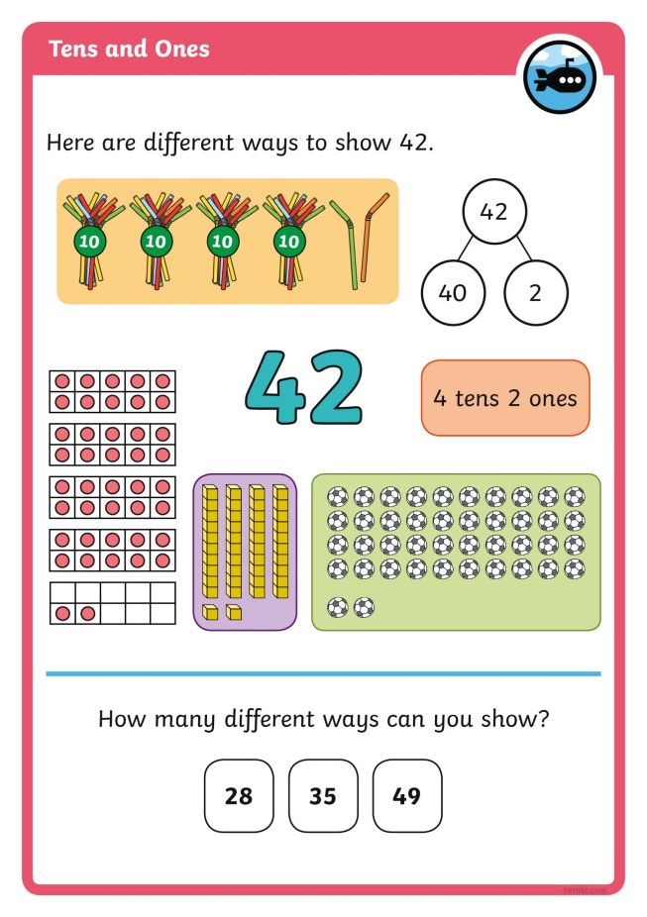
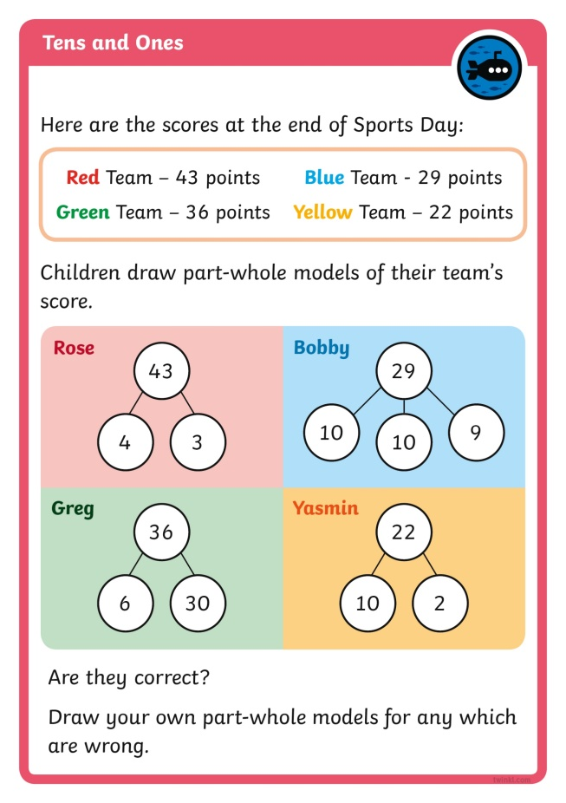

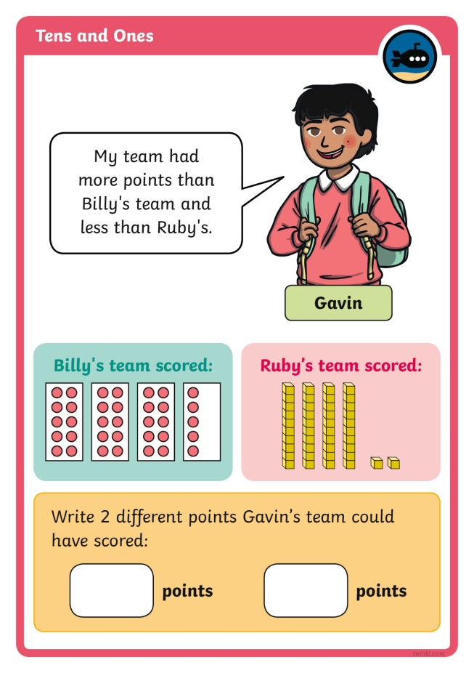
Diving into Mastery
Dive in by completing your own activity!

Slide 14
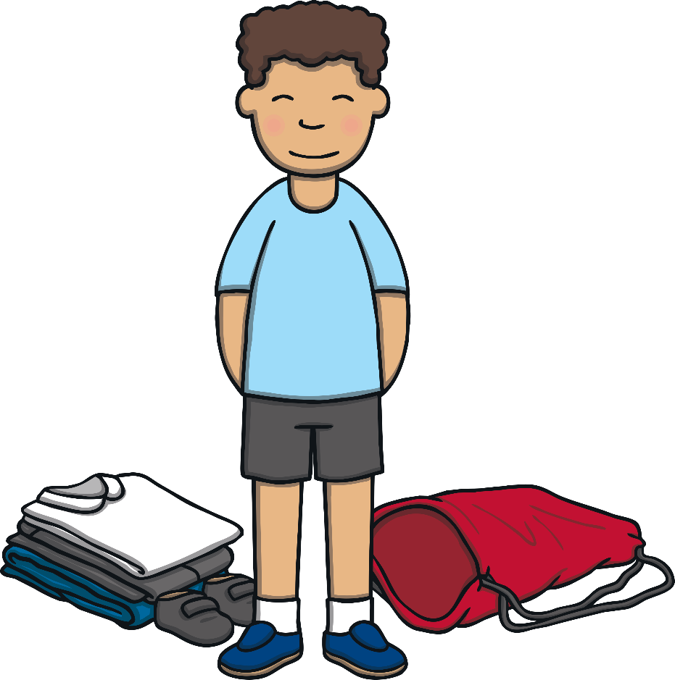
Tidy-Up Time
After sports day has finished, it’s time to tidy up the equipment.
Hamza is counting each item to check they have all been returned.
Can you count out the same number of objects?

Slide 15


Tidy-Up Time
How many cones does Hamza have?
Can you count out the same number of objects?
23

Slide 16

Tidy-Up Time
How many footballs does Hamza have?
Can you count out the same number of objects?
36

Slide 17
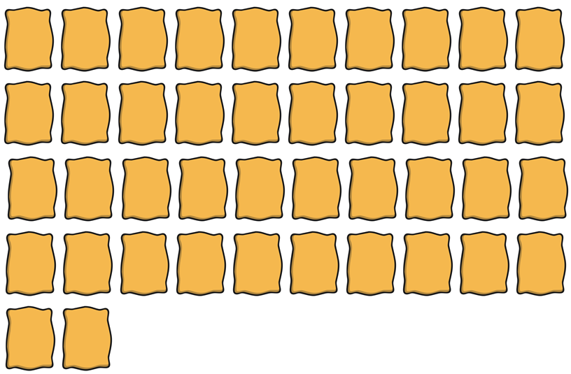
Tidy-Up Time
How many beanbags does Hamza have?
Can you count out the same number of objects?
42

Slide 18

Tidy-Up Time
How many beanbags does Hamza have?
Can you count out the same number of objects?
50

Slide 19
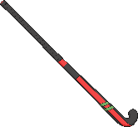
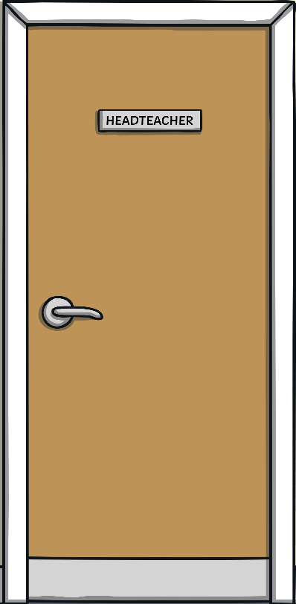

Tidy-Up Time
Does Hamza have the right amount of hockey sticks?
Can you count out the right number of objects?
25

Slide 20

Tidy-Up Time
Does Hamza have the right amount of basketballs?
Can you count out the right number of objects?
44

Slide 21

Aim
I can recognise and show numbers up to 50 using pictures.
Success Criteria
I can recognise written numbers up to 50.
I can recognise numbers up to 50 shown as pictures.
I can show numbers up to 50 using pictures.

